Slide 1
My Progress
Artificial intelligence model for continuous, in-home, posture and health monitoring including user feedback and predictions of clinical assessment.
David Faith Odesola
03/20/2024

Slide 2
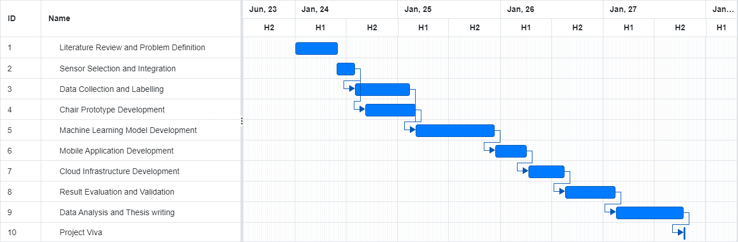
Gantt Chart

Slide 3


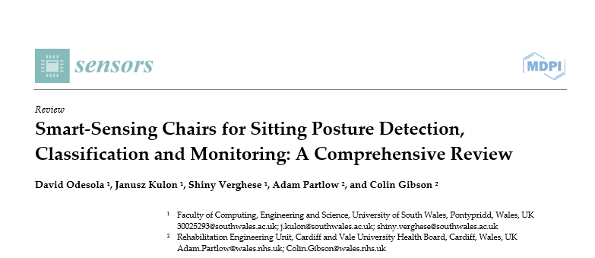
Journal Writing
Literature review on existing studies that implemented smart sensing chairs
34 Papers found

Slide 4
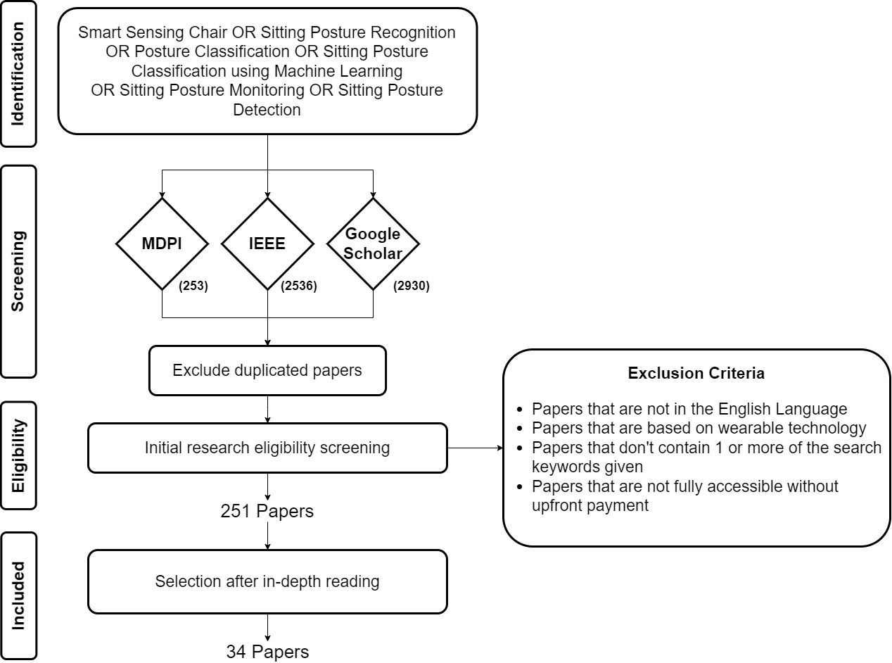
Methodology

Slide 5
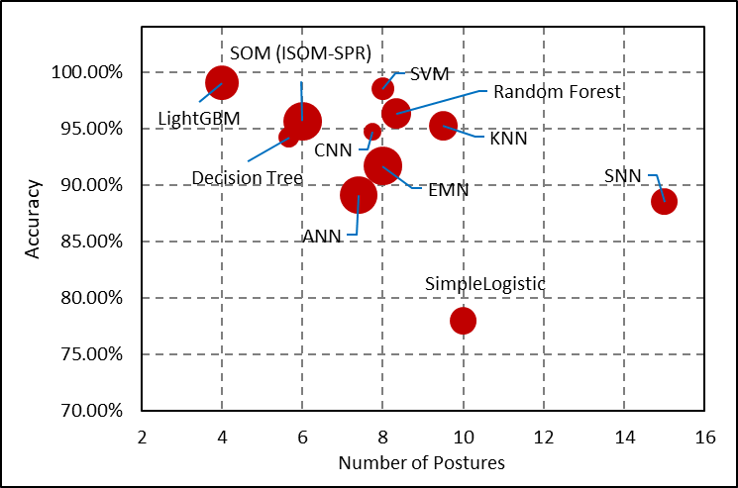
Comparison of Machine Learning Models
The more postures being classified, the lower the classification accuracy.
Neural Network Models don’t outperform statistical models

Slide 6
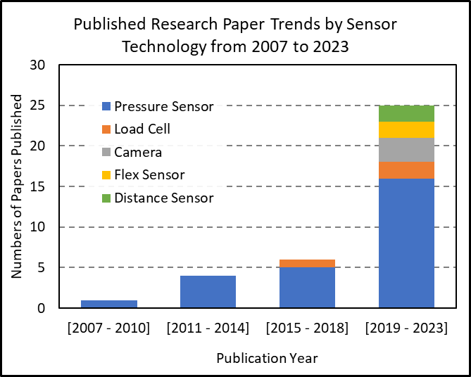
Trend of Sensor Technology among studies

Slide 7
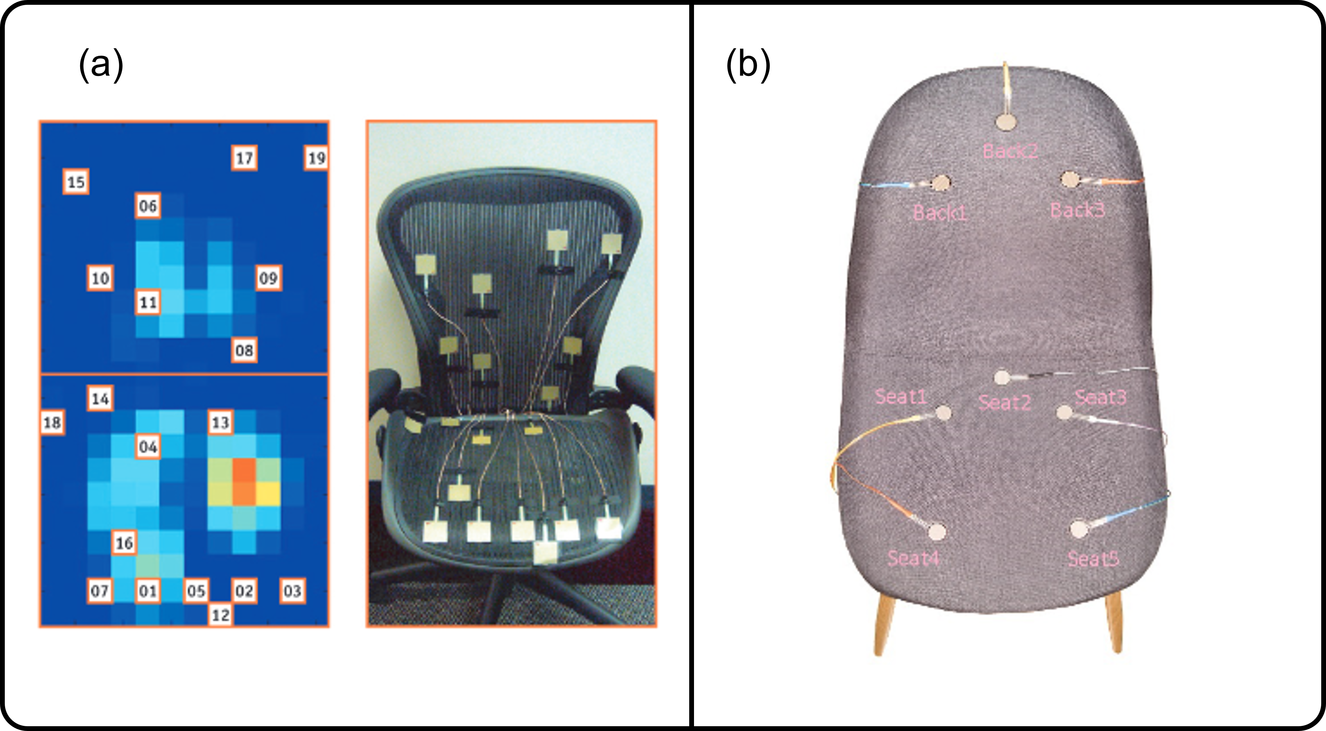
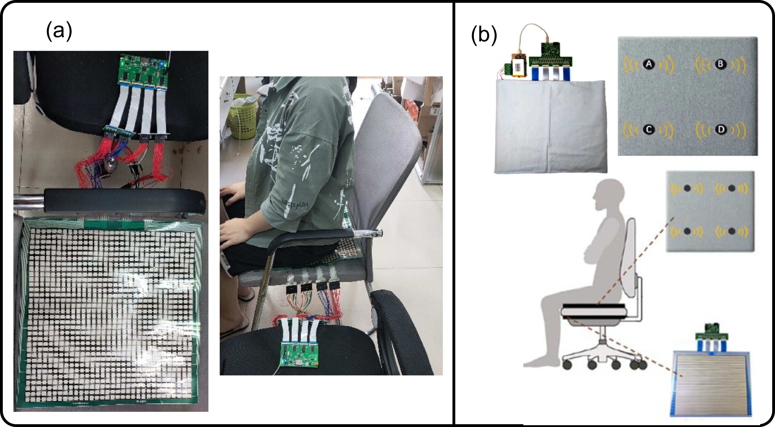
Sensor Placement Configuration
Dense Sensor Configuration
Sparse Sensor Configuration

Slide 8
Research Gaps
Lack of User Feedback Evaluation
Lack of diversity on the training dataset

Slide 9
Next Steps
Journal Submission
Experimentations

Slide 10
Thank You

